Slide 1
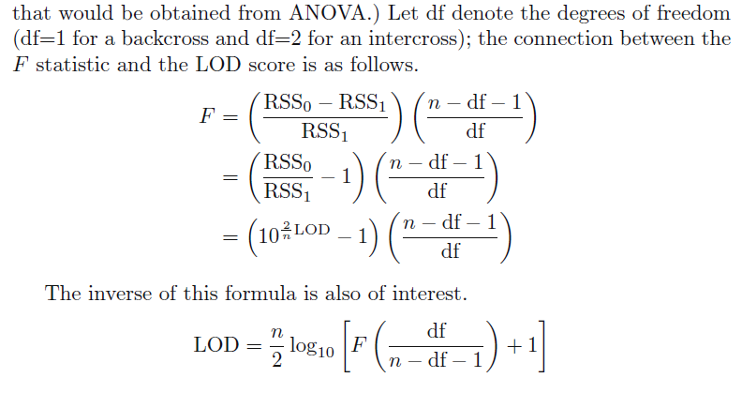
Marker regression

Slide 2
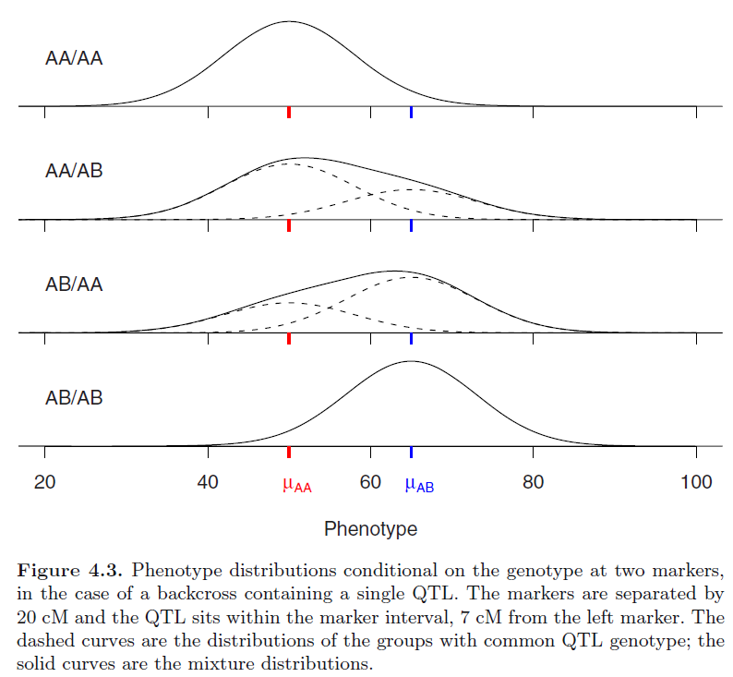
Simple Interval Mapping

Slide 3
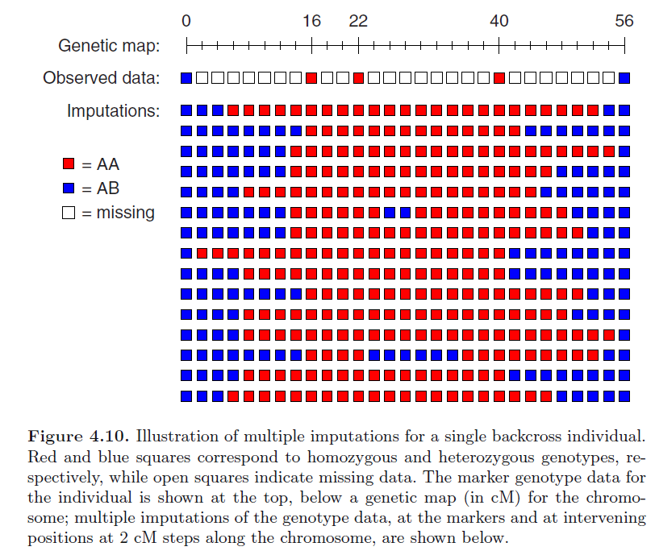
Imputation

Slide 4

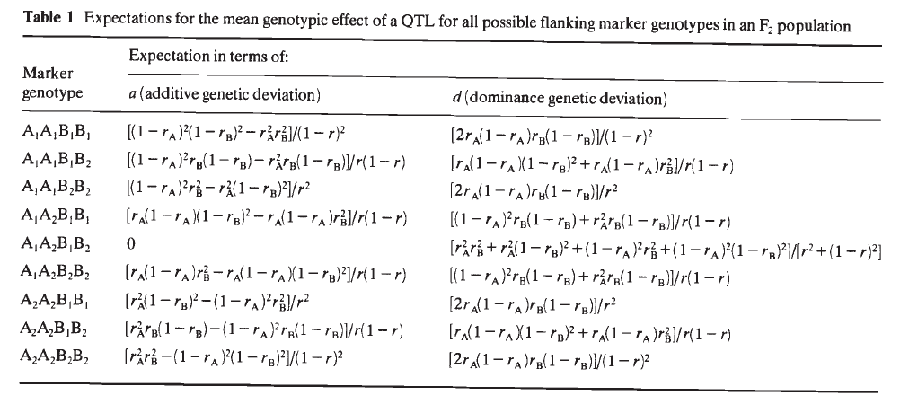
Haley & Knott regression
Pop F2 – phenotypes as a function of the marker genotypes

